Slide 1
ocean-based Carbon Dioxide Removal (CDR)
Prepared by Madison Wood

Slide 3
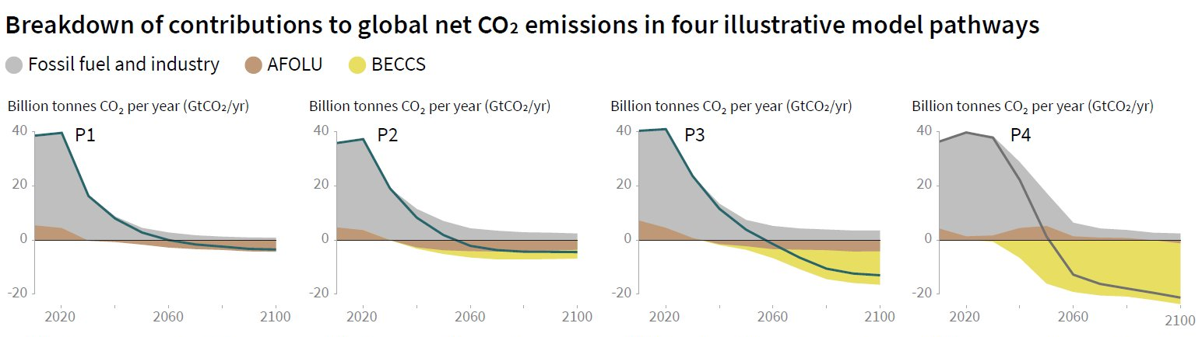
All [IPCC] pathways that limit global warming to 1.5°C with limited or no overshoot project the use of carbon dioxide removal (CDR) on the order of 100–1000 GtCO₂ over the 21st century.
IPCC, 2018: Summary for Policymakers

Slide 4
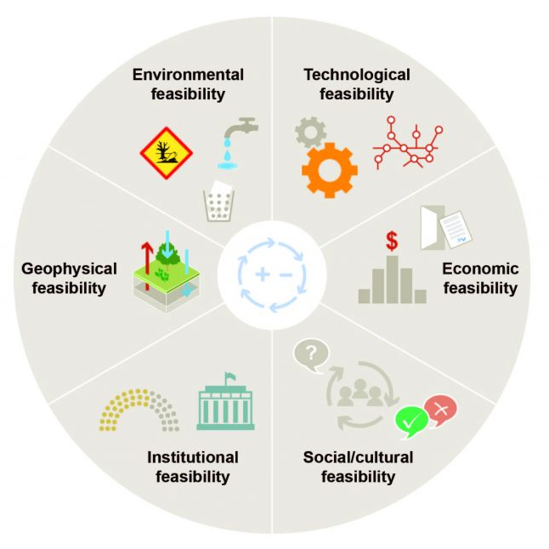
Large scale: remove 100–1000 GtCO₂ by 2100 (for context, we emit ~40 GtCO₂ per year)
Achieving CDR, or “negative emissions”
Multiple approaches: nature & tech-based solutions (none are risk-free, none are large-scale-ready)
Lots to do: R&D, finance, governance (we’ll talk mostly about R&D)
Adapted from C2G Carnegie Climate Governance Initiative resources
Image from IPCC Ch.4 FAQ

Slide 5
Types of CDR
Enhance existing natural processes that remove carbon from the atmosphere (e.g., by increasing its uptake by trees, soil, or other ‘carbon sinks’)
Use chemical processes to, for example, capture CO₂ directly from the ambient air and store it elsewhere (e.g., underground).
All CDR methods:
are at different stages of development: some are more conceptual, not yet tested at scale
have different potentials for achieving negative emissions
have different associated costs and side effects
Info from IPCC Ch.4 FAQ

Slide 6
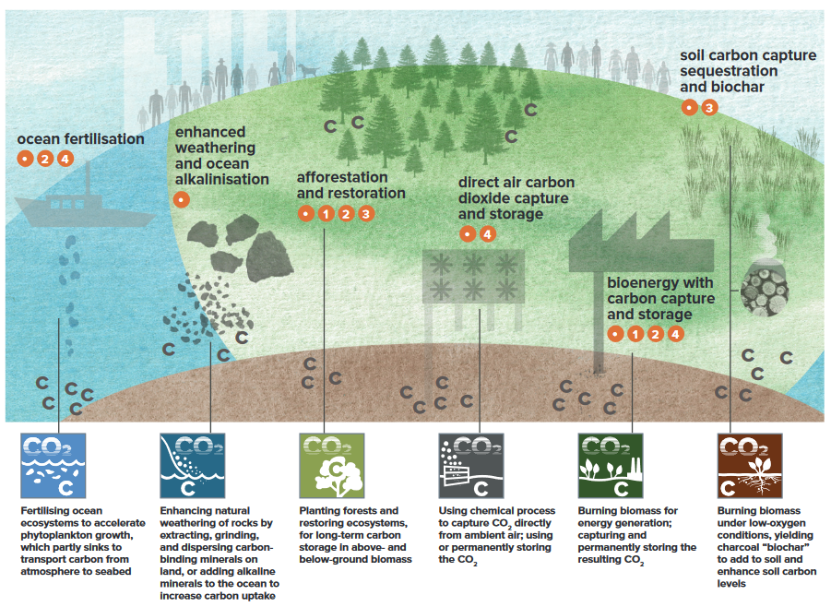
CDR Taxonomy
Less costly, closer to deployment
More costly, greater R&D needs
Infographic from C2G Carnegie Climate Governance Initiative, Taxonomy from climateworks.org

Slide 7
Marine, or ocean-based, CDR
“To date, most CDR development has been focused on land-based solutions.
Less known is another set of approaches to carbon removal with particularly strong potential – those that depend on the power and size of the ocean.”
- Ocean Visions

Slide 8
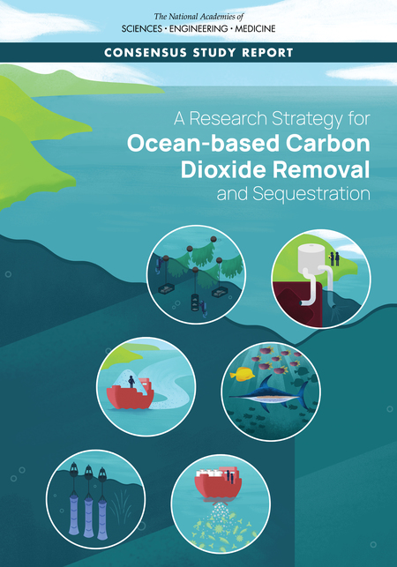
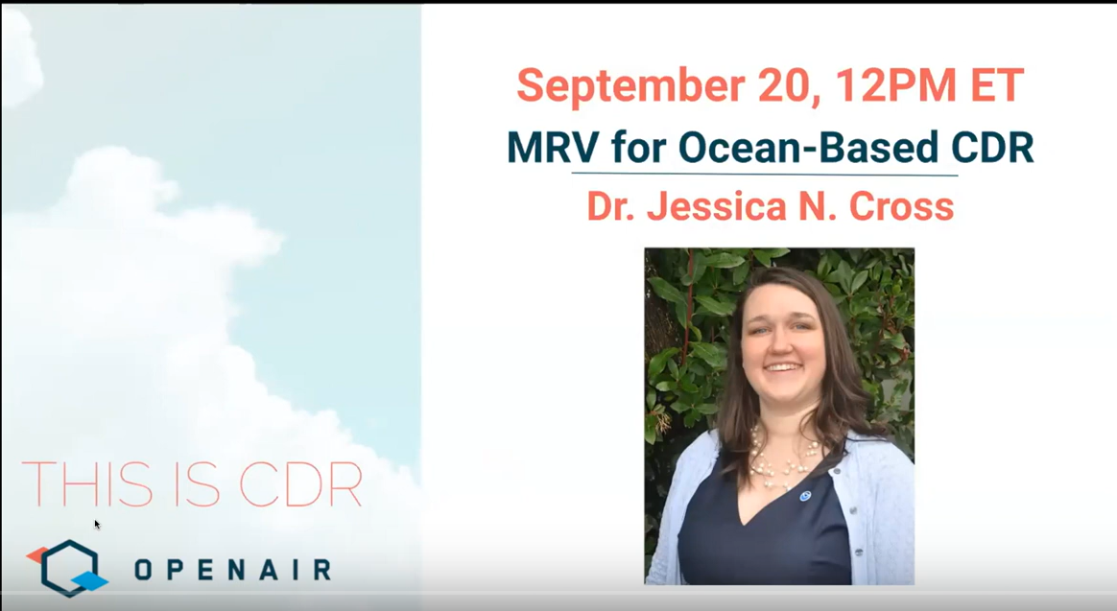

Slide 10
Ocean CDR
Artificial Downwelling
Deep Sea Storage
Electrochemical Ocean Capture
Macroalgal Cultivation
Marine Ecosystem Restoration
Microalgae Cultivation
Ocean Alkalinity Enhancement
Infographic from National Academies of Sciences, Engineering, and Medicine. 2021.

Slide 11
Assessment Criteria
Knowledge Base
Efficacy
Durability
Scale
Monitoring & Verification
Environmental & Social Impacts
Governance & Social Dimensions
A research strategy for ocean-based carbon dioxide removal and sequestration (2021). National Academies of Sciences, Engineering, and Medicine

Slide 12
Assessment Criteria
Knowledge Base
common challenges:
inadequate
based only on laboratory-scale experiments, conceptual theory and/or numerical
A research strategy for ocean-based carbon dioxide removal and sequestration (2021). National Academies of Sciences, Engineering, and Medicine

Slide 13
Assessment Criteria
Governance
common challenges:
social & regulatory acceptability
role of CDR generally, plus project-scale discussions
A research strategy for ocean-based carbon dioxide removal and sequestration (2021). National Academies of Sciences, Engineering, and Medicine

Slide 14
Assessment Criteria
Monitoring & Verification
common challenges:
how do we quantify efficacy and durability, plus impacts?
MRV necessary for governance and markets
A research strategy for ocean-based carbon dioxide removal and sequestration (2021). National Academies of Sciences, Engineering, and Medicine

Slide 15
Assessment Criteria
Environmental & Social Impacts
common challenges:
all strategies modify marine environments in some way
knowledge base is weak regarding intended & unintended consequences
A research strategy for ocean-based carbon dioxide removal and sequestration (2021). National Academies of Sciences, Engineering, and Medicine

Slide 16
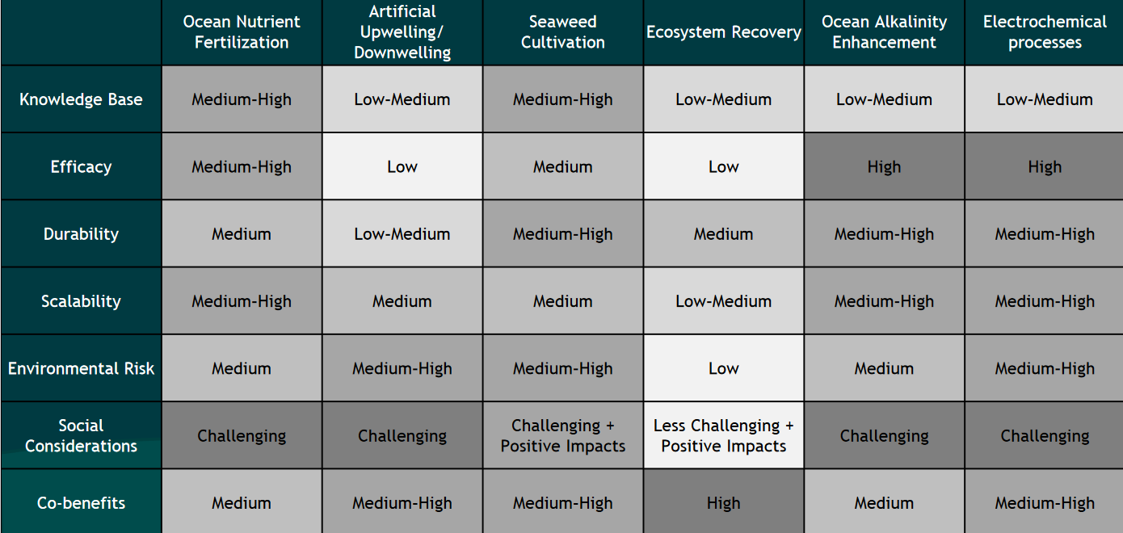
A research strategy for ocean-based carbon dioxide removal and sequestration (2021). National Academies of Sciences, Engineering, and Medicine
Notes:
https://nap.nationalacademies.org/resource/26278/Ocean_CDR_2021.pdf
file:///C:/Users/maddi/Downloads/ocean%20cdr%20public%20briefing%20presentation_final-1.pdf
https://nap.nationalacademies.org/read/26278/chapter/2#10
https://www2.oceanvisions.org/roadmaps/
https://oceanvisions.org/ocean-based-carbon-dioxide-removal/

Slide 17
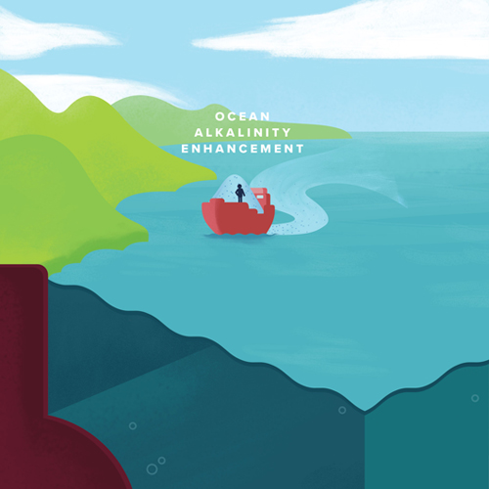
Ocean Alkalinity Enhancement
aka “enhanced weathering” (if on land)
Inspired by Earth’s modulation of alkalinity on geological timescales: adding alkalinity via natural or enhanced weathering is counteracted by the precipitation of carbonate, which reduces alkalinity
A research strategy for ocean-based carbon dioxide removal and sequestration (2021). National Academies of Sciences, Engineering, and Medicine

Slide 18
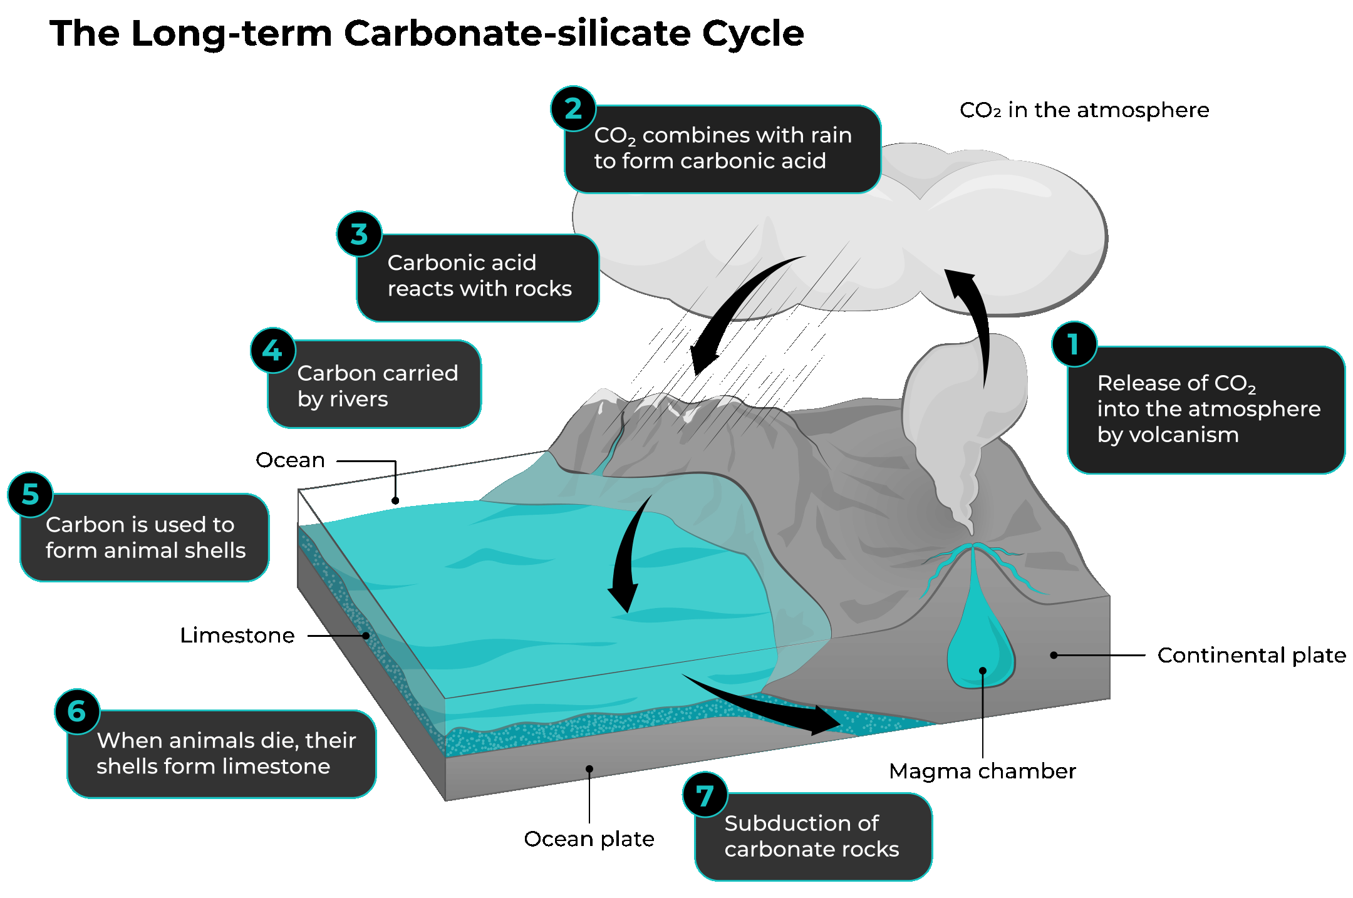
OAE – Scientific Principles
Infographic from Vesta

Slide 19
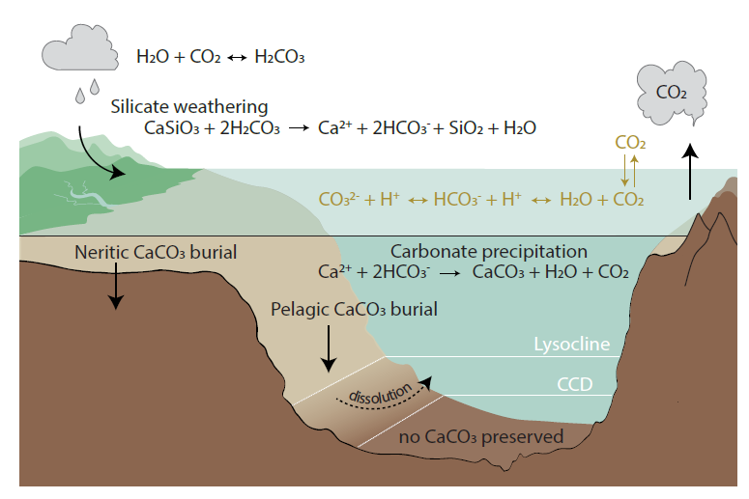
OAE – Scientific Principles
Using quicklime:
Using olivine:
add alkalinity to shift the partitioning of inorganic carbonate species, lowering ocean pCO₂
CO₂ uptake potential
pH

Slide 20
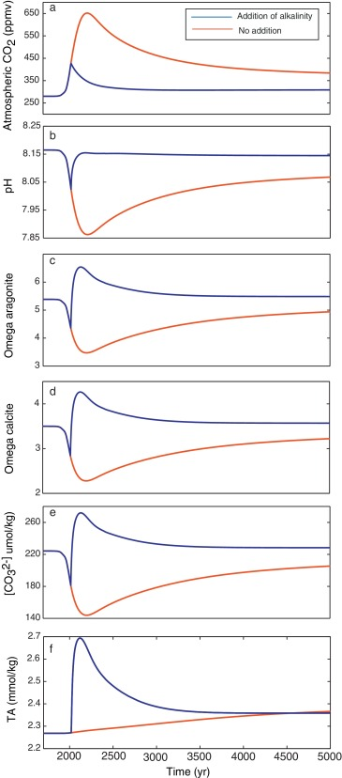
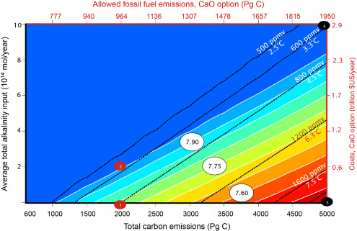
OAE – Scientific Principles
1500 Pg C over 500 years
Assessing possible consequences of ocean liming on ocean pH, atmospheric CO₂ concentration and associated costs. Paquay & Zeebe (2013)
LOSCAR model, add alkalinity from 2020 to 2400 under various emissions scenarios
Alk inputs are 2 to 10 × 10¹⁴ mol/year in 1500–5000 Pg C total emissions.
∼$103-144 per ton of CO₂

Slide 22
Silicate & carbonate minerals
Alkaline materials from mining waste
Electrochemical generation of alkalinity
Deployment (where & how)
Monitoring
Domino-effect impacts?
A research strategy for ocean-based carbon dioxide removal and sequestration (2021). National Academies of Sciences, Engineering, and Medicine

Slide 23
Outlook
Potential to promote CO₂ uptake from the atmosphere while mitigating ocean acidification
“Permanent” CO₂ sequestration on timescales of millennia or longer (in the absence of processes that remove the added alkalinity, which are slow)
Proposed minerals are abundant in Earth’s crust, but there are associated costs, logistics, and environmental impacts of supply (mining, transportation)
A research strategy for ocean-based carbon dioxide removal and sequestration (2021). National Academies of Sciences, Engineering, and Medicine

Slide 24
Outlook
Can represent a source of nutrients and trace metals (good or bad?)
How will OAE alter local and global biogeochemical cycles?
What kinds of global processes do we have to worry about? CO₂ outgassing in some regions? Increase in albedo from limestone powder?
A research strategy for ocean-based carbon dioxide removal and sequestration (2021). National Academies of Sciences, Engineering, and Medicine

Slide 25
Outlook
Where can OAE be deployed? Coastal areas susceptible to acidification could be good candidates.
What kind of infrastructure is needed? Expanded mining, ports, vessels, monitoring stations, etc.
What are the social/environmental/economic costs?
Many technical, environmental, logistical, social, and ethical questions remain.
A research strategy for ocean-based carbon dioxide removal and sequestration (2021). National Academies of Sciences, Engineering, and Medicine

Slide 26
Assessment Criteria - OAE
Knowledge Base
Low – medium
Seawater–CO₂ system is understood
Need empirical data on alkalinity enhancement; currently, knowledge is based on modeling work.
High uncertainty for possible impacts.
A research strategy for ocean-based carbon dioxide removal and sequestration (2021). National Academies of Sciences, Engineering, and Medicine

Slide 27
Assessment Criteria - OAE
Efficacy
High confidence
Field studies needed to quantify CDR, and effects on ocean chemistry
A research strategy for ocean-based carbon dioxide removal and sequestration (2021). National Academies of Sciences, Engineering, and Medicine

Slide 28
Assessment Criteria - OAE
Durability
Medium - High
>100 years
Processes for removing alkalinity are slow
A research strategy for ocean-based carbon dioxide removal and sequestration (2021). National Academies of Sciences, Engineering, and Medicine

Slide 29
Assessment Criteria - OAE
Scalability
Medium - High
Potential for sequestering >1 Gt CO₂/yr if applied globally
Uncertainty around unintended chemical impacts or export to depth of added minerals
A research strategy for ocean-based carbon dioxide removal and sequestration (2021). National Academies of Sciences, Engineering, and Medicine

Slide 30
Assessment Criteria - OAE
Environmental Risk
Medium (low confidence)
Toxic effects of trace metal additions
Effects from mining
Unintended consequences for biological communities
A research strategy for ocean-based carbon dioxide removal and sequestration (2021). National Academies of Sciences, Engineering, and Medicine

Slide 31
Assessment Criteria - OAE
Co-benefits
Medium (low confidence)
Counter ocean acidification
Positive for fisheries
A research strategy for ocean-based carbon dioxide removal and sequestration (2021). National Academies of Sciences, Engineering, and Medicine

Slide 32
Assessment Criteria - OAE
Cost of scale up
Medium - high
>$100–$150/ton CO₂
Cost of mining, transportation, ocean fleets
A research strategy for ocean-based carbon dioxide removal and sequestration (2021). National Academies of Sciences, Engineering, and Medicine

Slide 33
Assessment Criteria - OAE
Cost of monitoring & accounting
Low - medium
Mostly on the “unintended consequences” side of monitoring
Substantial portion of cost during R&D
A research strategy for ocean-based carbon dioxide removal and sequestration (2021). National Academies of Sciences, Engineering, and Medicine

Slide 35
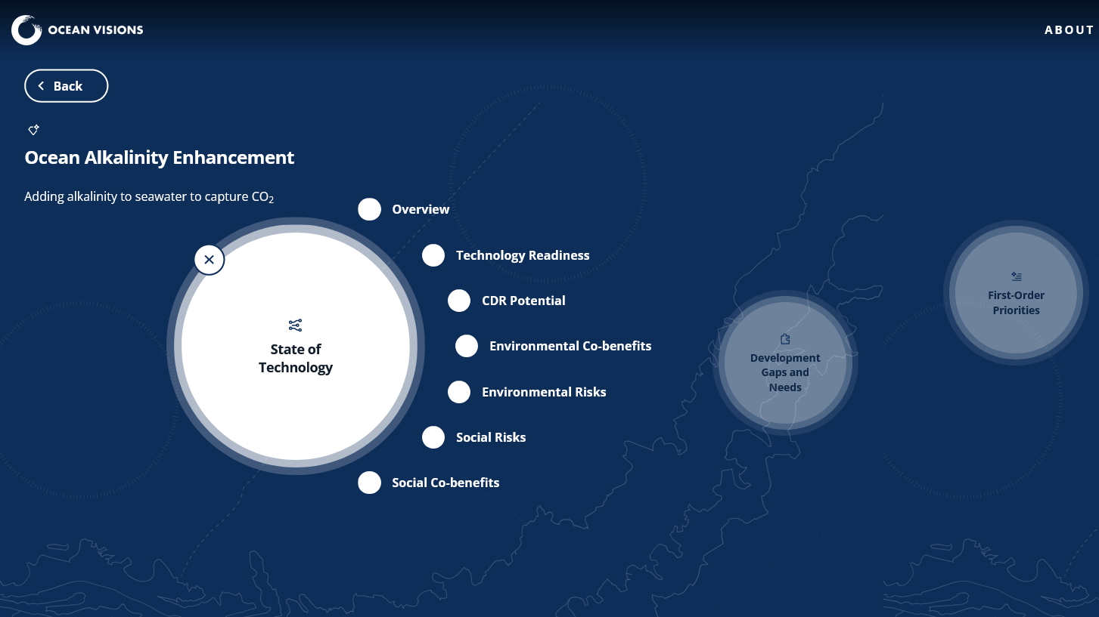

Slide 36
What’s needed?
(Building on lab trials), field trials are needed to study mineral dissolution kinetics, dynamics of carbonate chemistry, biogeochemical & biological impacts, technological readiness, etc.
(e.g., Vesta, Ocean NETS)
Along with chemistry & deployment, monitoring & verification plans must be developed.
A research strategy for ocean-based carbon dioxide removal and sequestration (2021). National Academies of Sciences, Engineering, and Medicine

Slide 37
(Project) Vesta
“From Pilot Project to Gigaton-scale CO₂ Removal”
Olivine deployment for Coastal Carbon Capture

